Slide 1

Introduction to Big Data
KERAS
University of Science VNUHCM
Topic: ML1 - Keras
Team: KHMT1 - 02 Kinchana

Slide 2

—Veronica Roth
“We are not the same. But we are, somehow, one.”
Le Anh Thu 21127175
Nguyen Nhat Truyen 21127191
Nguyen Minh Dat 21127592
Huynh Duc Thien 21127693

Slide 3
TABLE OF CONTENTS
01
02
03
04
Introduction
Insights
History, origin of Keras
Population
Demonstration
Conclusion
Usage and Application
In summary

Slide 4
01
Introduction
History of Deep Learning and breakthrough of new era

Slide 5
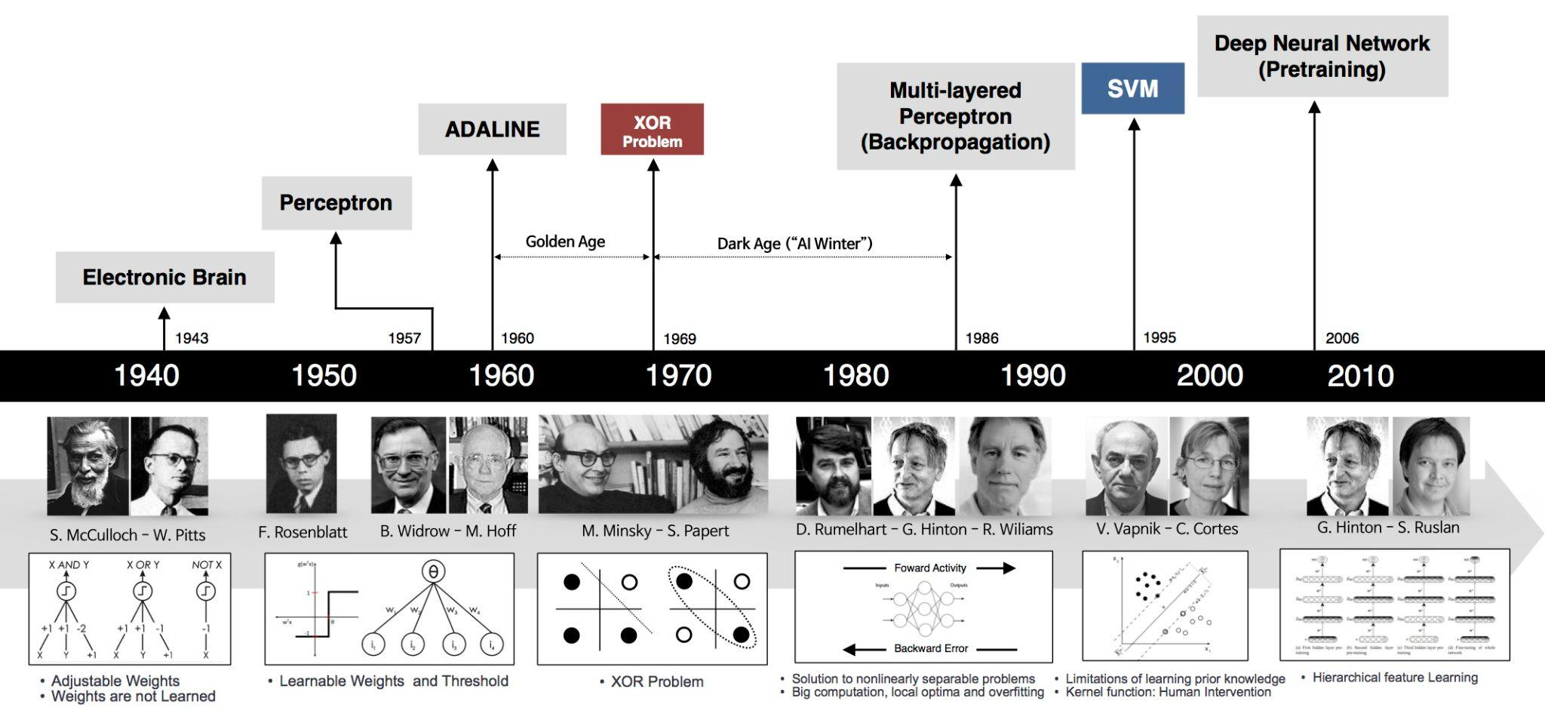
History of Deep Learning
Source: Deep Learning 101 - Part 1: History and Background

Slide 6
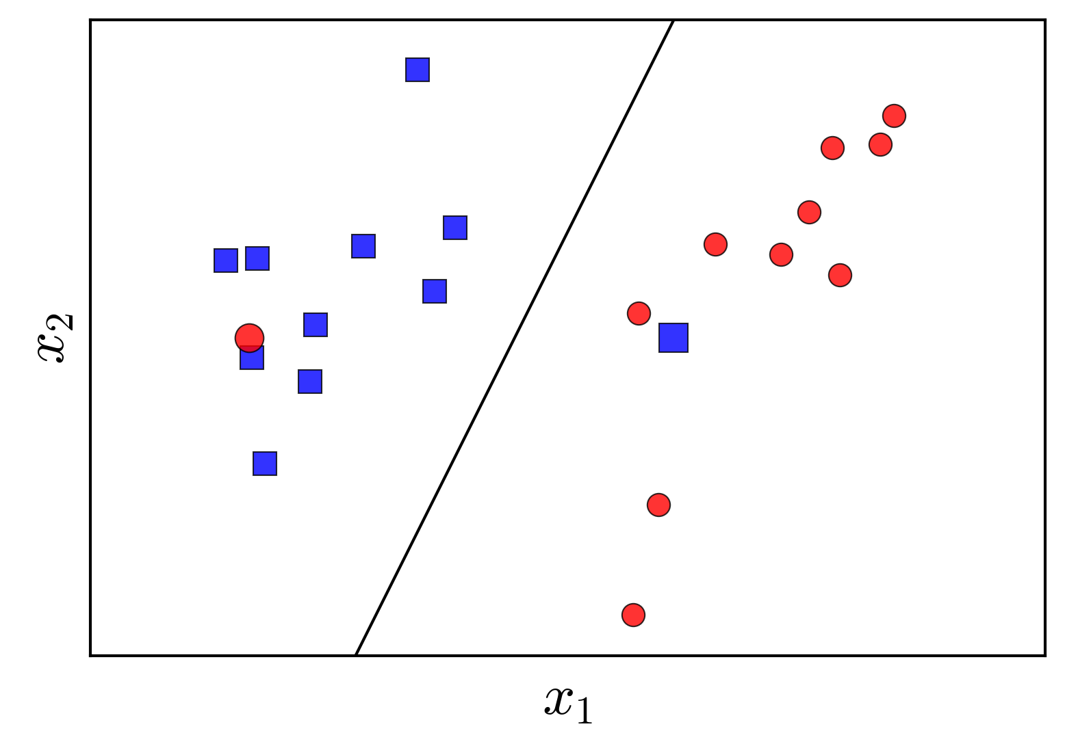
1960s: Perceptron Learning Algorithm (PLA)
Only work with linearly separable data →The 1st AI winter

Slide 7
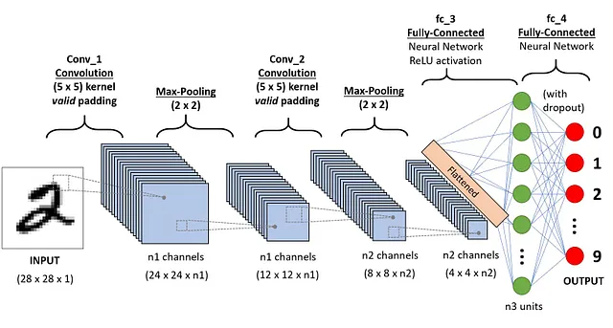
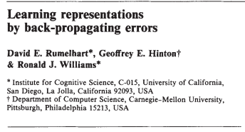
1980s: MLP and Backpropagation
Multi-layer Perceptron (MLP)
Backpropagation
Convolutional Neural Nets

Slide 8
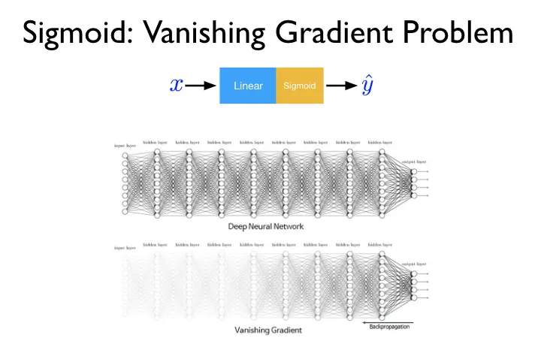
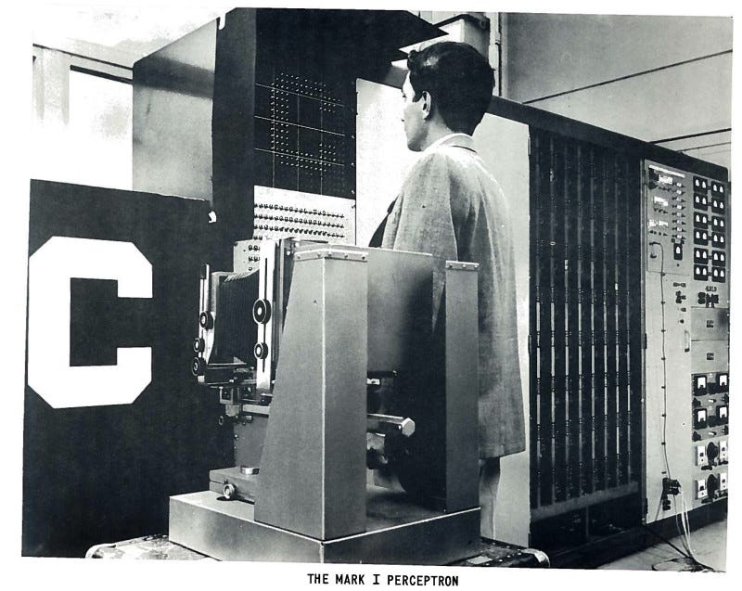
1990-2000s: The 2nd AI Winter
Data & Computing Limitation

Slide 9

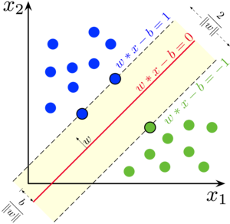
1990-2000s: The 2nd AI Winter
Support Vector Machines (SVM)

Slide 10

2010s: ImageNet Dataset
Top-5 error rate in 2010 is 28%
Top-5 error rate in 2011 is 26%

Slide 11
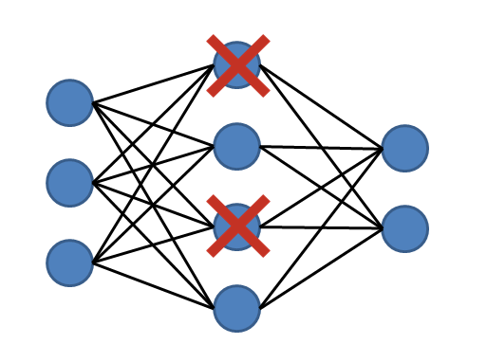
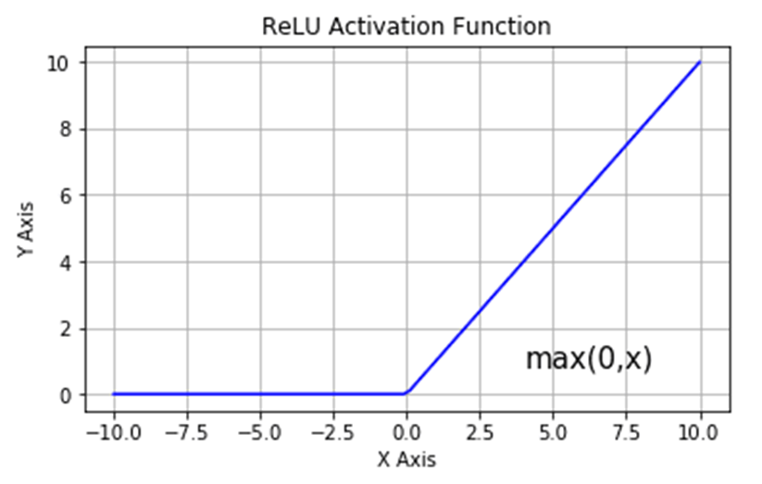
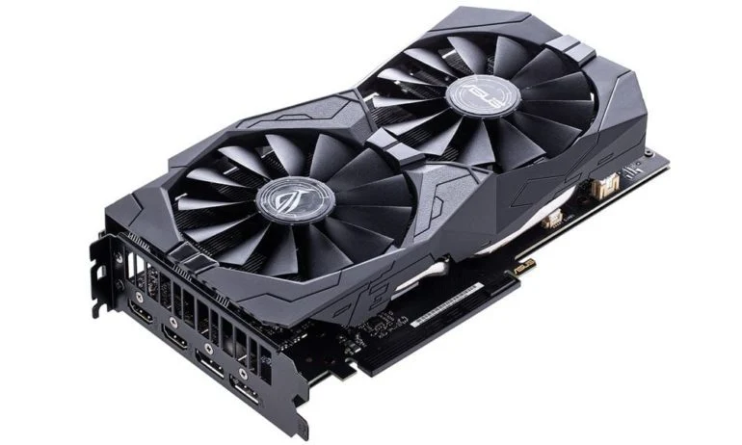
2012s: Deep Convolutional Neural Network
Top-5 error rate in 2012 is 16%

Slide 12
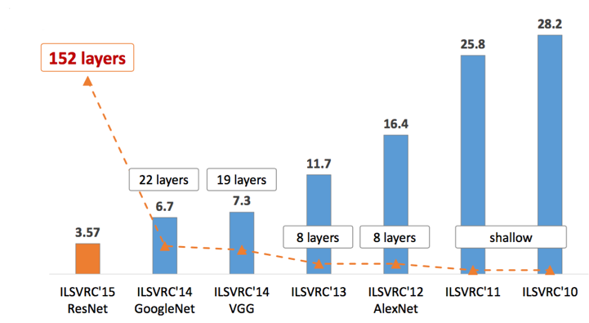
2012s-now: “Deep” in Deep Learning
Source: CNN Architectures: LeNet, AlexNet, VGG, GoogLeNet, ResNet and more ...

Slide 13
02
Insights

Slide 14
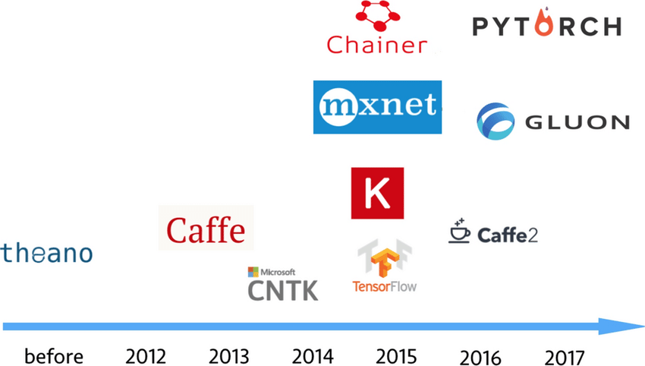
Breakthrough of DL Framework
Source: DLBench: a comprehensive experimental evaluation of deep learning frameworks

Slide 15
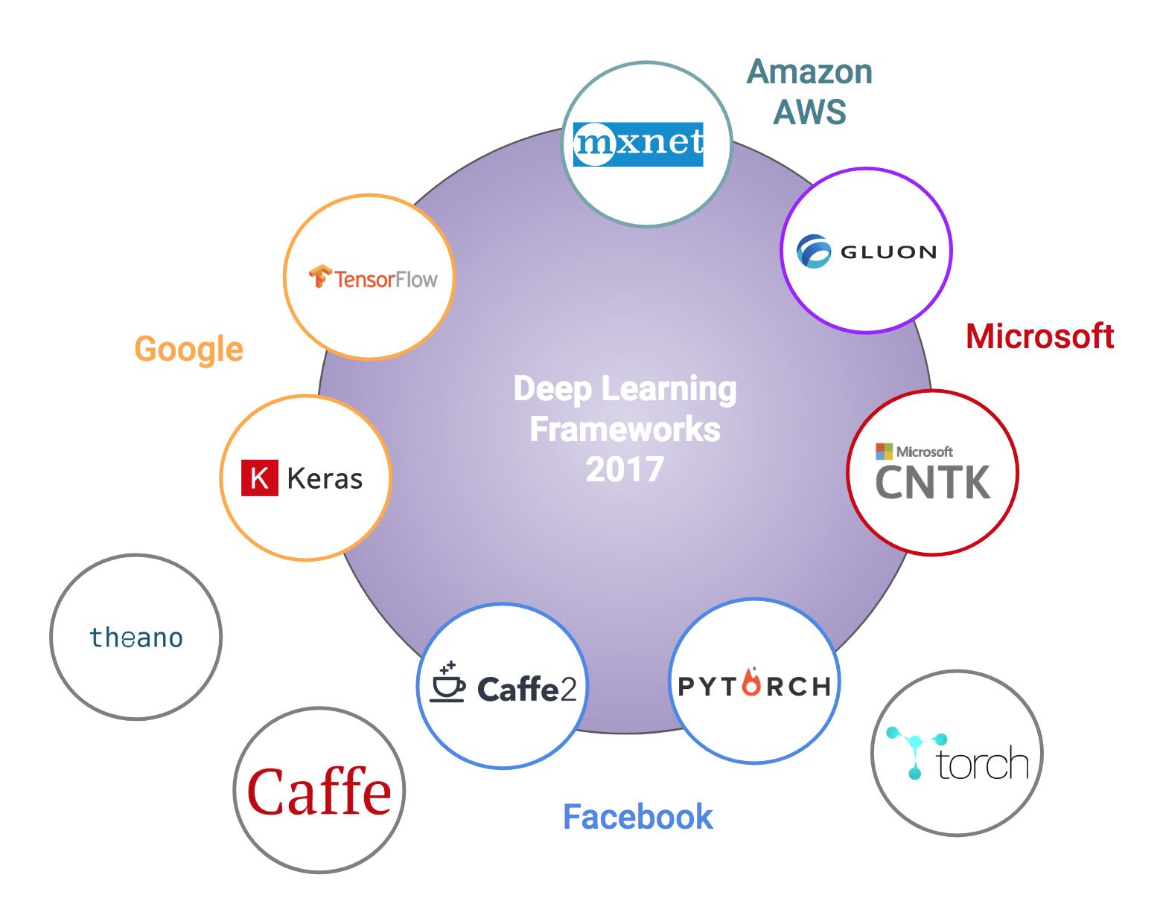
Deep Learning Frameworks
Source: Battle of the Deep Learning frameworks — Part I: 2017, even more frameworks and interfaces

Slide 16
A Good Framework must have
01
02
03
04
05
06
GPU
Languages
OS
Computing with GPUs and distributed systems
C/C++, Python, Java,...
Windows, Linux, MacOS
model zoo
Backpropagation
Community
Contains commonly trained deep learning models
Supports automatic backpropagation calculation
A large contributing community

Slide 17
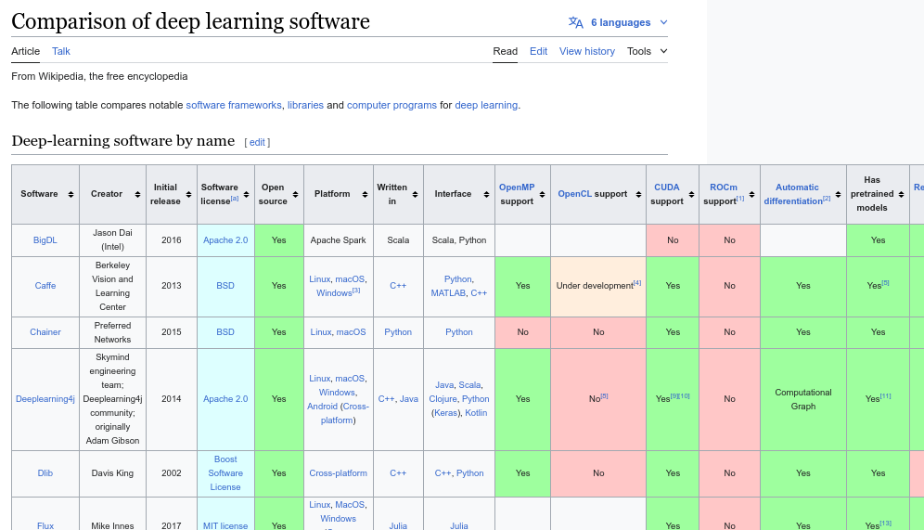
Source: Comparison of deep learning software

Slide 18
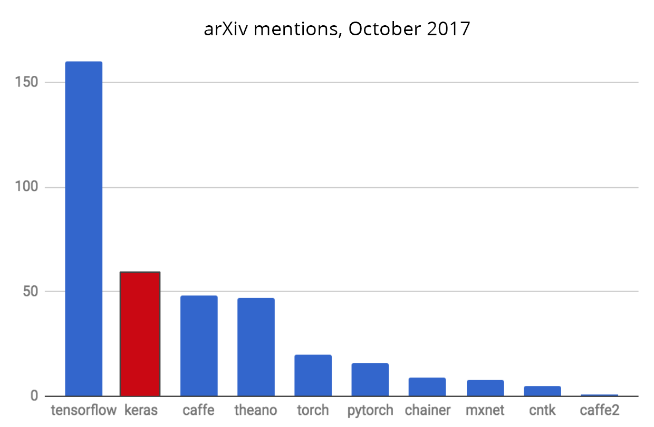

Slide 19
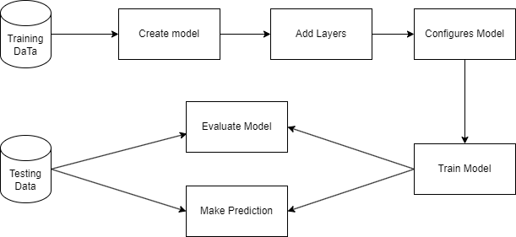
Keras Components
Keras Model Workflow

Slide 20
01
02
03
04
05
06
07
Keras Components
Sequential Model
Add Layer
Dense Layer
Model Compilation
multi-layer perceptron
Fully connected layer: Interconnected nodes, specified by parameters
add() is used to add a layer to the neural network
Compile the model with optimizer and loss function
Model Training
Make Predictions
Model Evaluation
fit() used to train the model
predict() is used to make predictions on new input data
evaluate() is used to assess the model performance

Slide 21
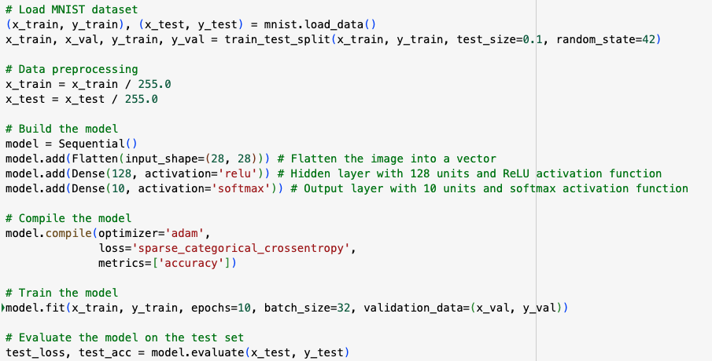
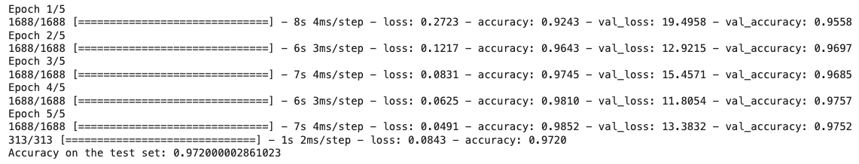
Keras Components

Slide 22
03
Demonstration

Slide 23
PROBLEM STATEMENT
Pneumonia
Affects our lungs
Caused by bacteria, viruses… Leads to fluid air sacs or alveoli
Health care

Slide 24
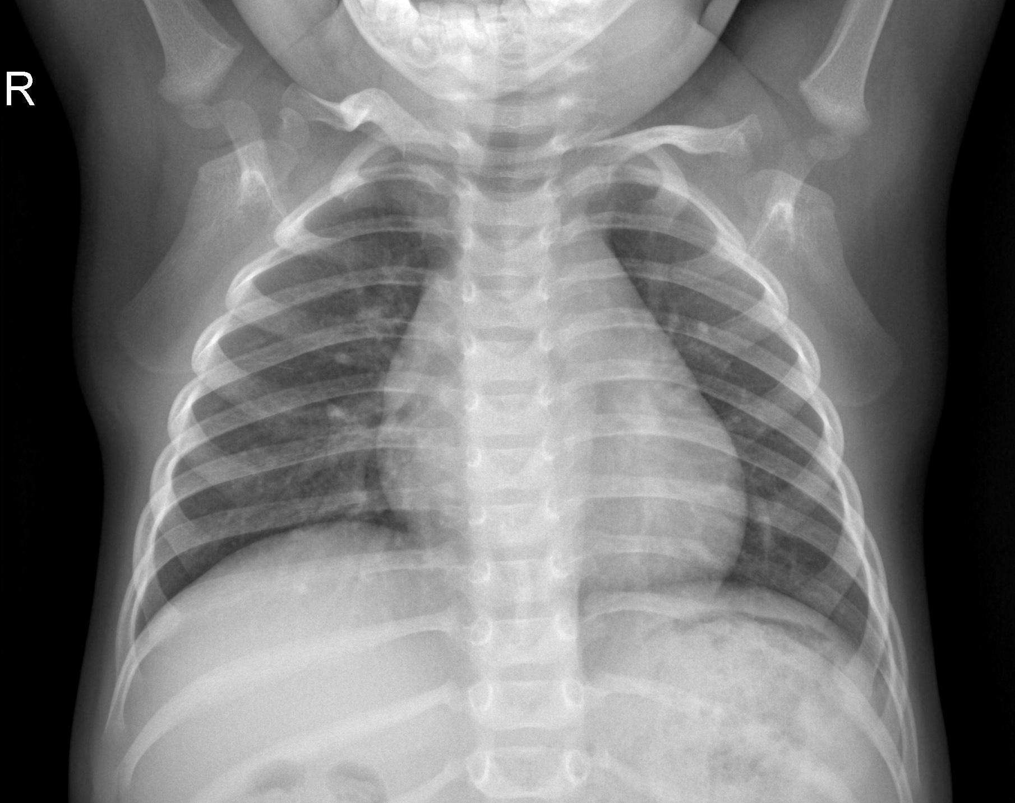


PROBLEM STATEMENT
Combination

Slide 25


PROBLEM STATEMENT
Making Prediction

Slide 26
KERAS PIPELINE
01
02
03
04
Description
Explore
Preprocess
Implement

Slide 27
KERAS PIPELINE
01
02
03
04
Description
Explore
Preprocess
Implement

Slide 28
DATA DESCRIPTION
01
02
03
04
Structure
Quantity
Organized into 3 folders train - test - val
5,863 X-Ray images
Pneumonia/Normal
Origin
Quality
Guangzhou Women and Children’s Medical Center
Under quality control process

Slide 29
KERAS PIPELINE
01
02
03
04
Description
Explore
Preprocess
Implement

Slide 30
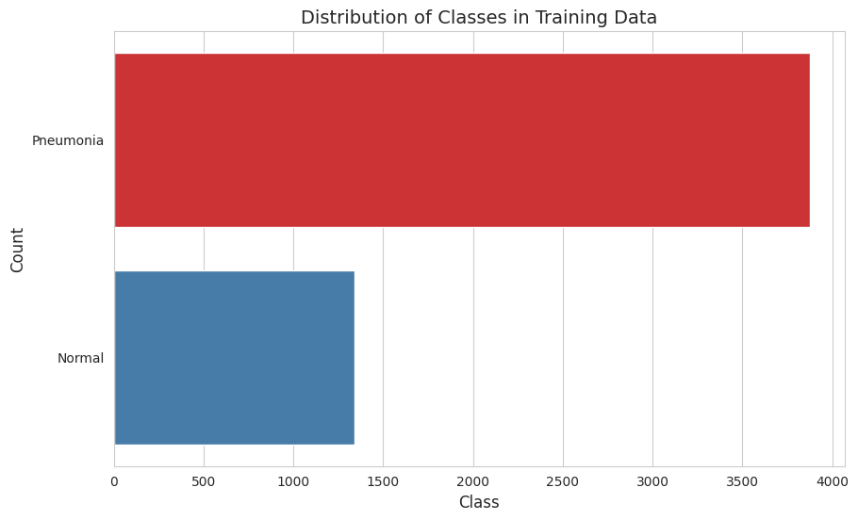
Distribution

Slide 31
KERAS PIPELINE
01
02
03
04
Description
Explore
Preprocess
Implement

Slide 32
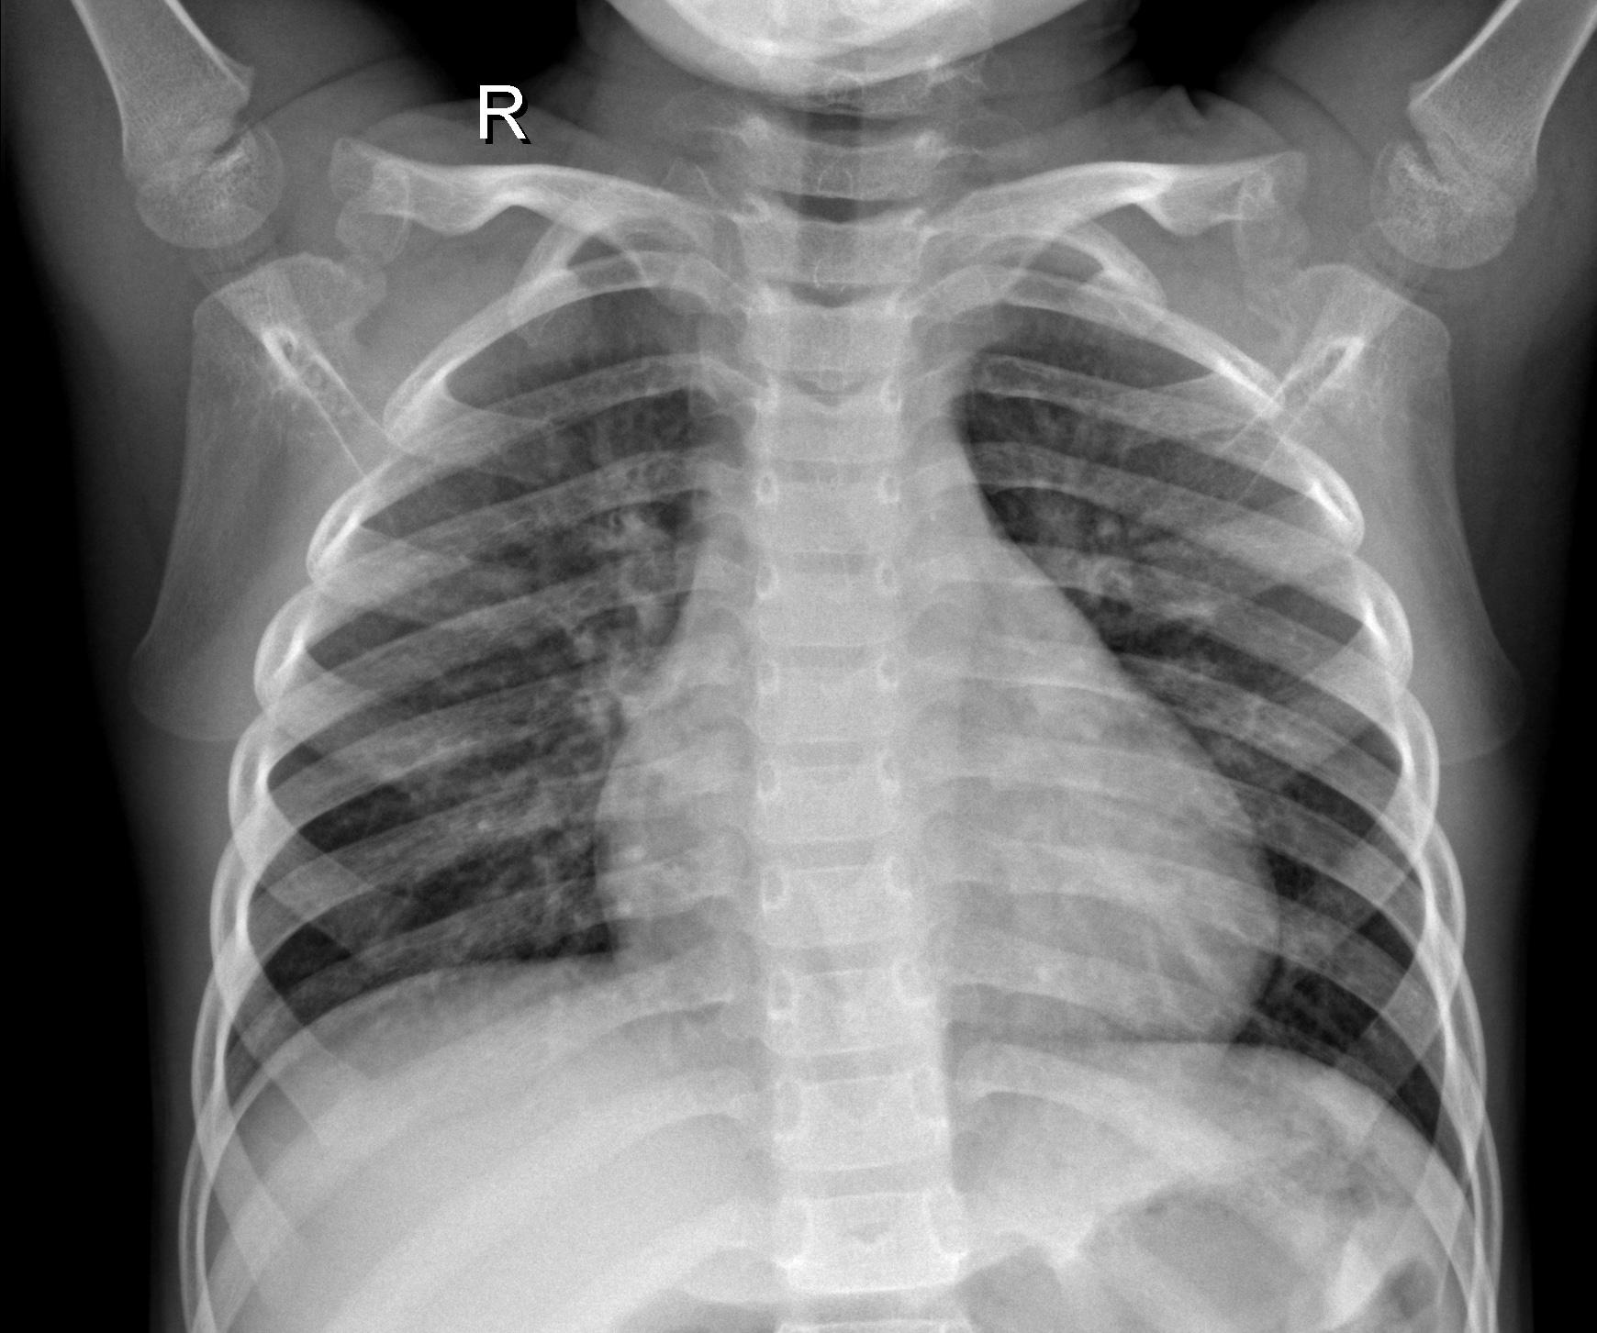
Normalization
Reshape
Rescale
(N, width, length, channel)
Scale from [0, 255] to [0, 1]

Slide 33
Data Augmentation
01
02
03
Size
Variation
Role
Expand the size of the dataset
Resize, rotate, flip, shift, normalize,...
Help model generalize and avoid overfitting

Slide 34
Keras ImageDataGenerator
01
02
Functionalities
Advantages
Return new variations of images at each epoch
Do not change the original images
Loading the images in batches
Requires lower memory usage

Slide 35
KERAS PIPELINE
01
02
03
04
Loading
Explore
Preprocess
Implement

Slide 36
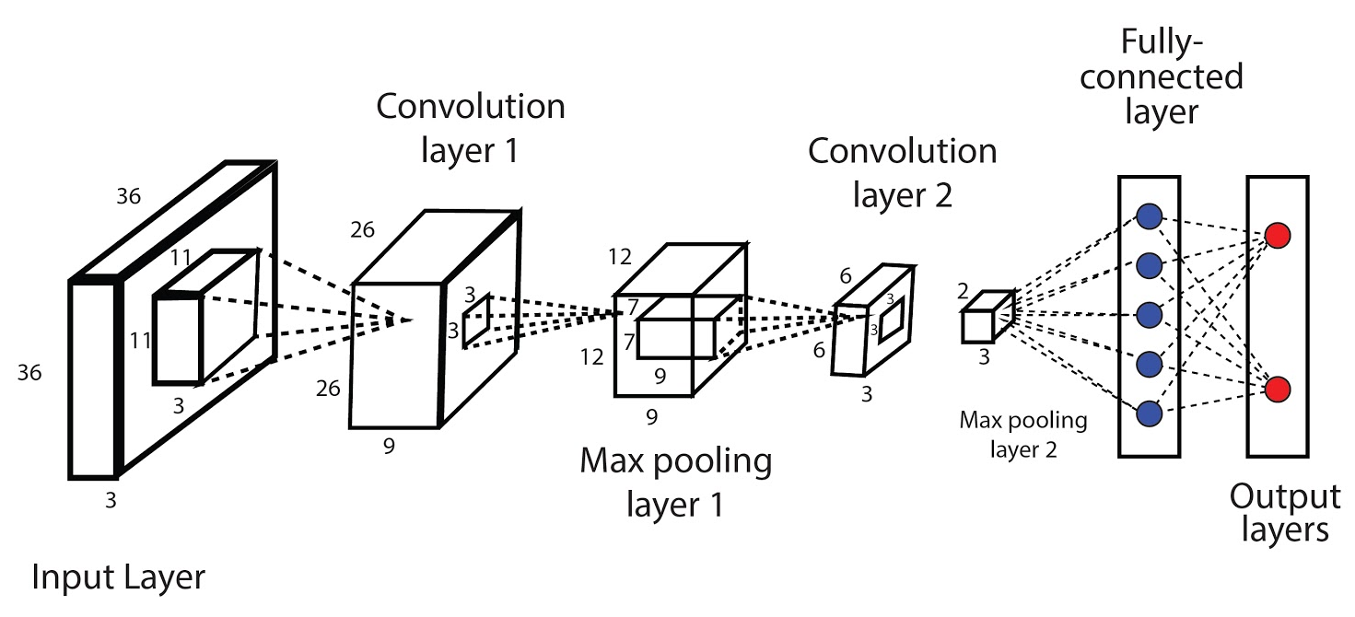
MODEL
5
5
4
2
Conv Layers
MaxPooling2D
Batch Normalization
Dropout

Slide 37
PYTORCH PIPELINE
01
02
03
Additional Preprocess
Transform
Sampler

Slide 38
Additional Preprocessing
01
02
03
04
Nested dir
.csv file
PNEUMONIA—
h1.img——
h2.img——
NORMAL—
h3.img——
h4.img——
“h1.img” 1
“h2.img” 1
“h3.img” 0
“h4.img” 0
Image dir
Custom Dataset
h1.img
h2.img
h3.img
h4.img

Slide 39
PyTorch transform
Keras ImageDataGenerator
PyTorch transform
In Keras, the ImageDataGenerator can be fit to data and automatically compute the internal data stats
In PyTorch, we have to compute the stats on our own and in advance
Normalization
Have to compute mean and std

Slide 40
Weighted Random Sampler
75%
25%
PNEUMONIA
NORMAL
Problem:
Model may be tempted to predict Pneumonia
Solution:
Assign a higher probability of being selected to samples from the Normal class

Slide 41
In a nutshell
Transform
Sampler
+
Diversify dataset
Tackle imbalanced
→ Model can generalize well, avoid biased and overfitting.

Slide 42
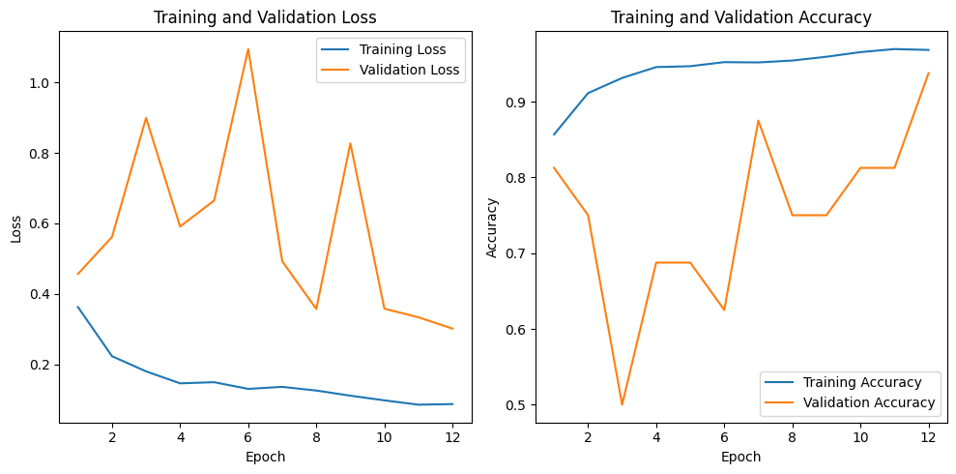
Evaluation

Slide 43
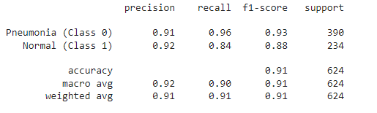
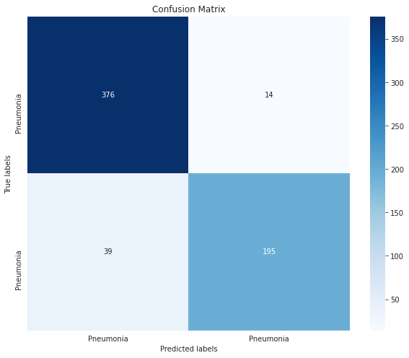
Evaluation
Accuracy: 91%

Slide 44
CONCLUSIONS
Keras
PyTorch
Easy to use
High-level API
Low performance
More complex
More flexibility
High performance
Side note: Data processing can make a difference.

Slide 45
Thanks for listening!
Any further questions, please contacts
hdthien21@clc.fitus.edu.vn
teamKinchana

